Slide 1
Computer Vision with Embedded Machine Learning
Object Detection Performance Metrics

Slide 2
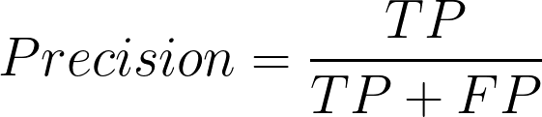
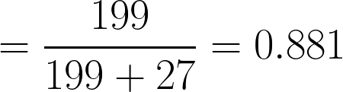
Confusion Matrix
Predicted Label
 | Ball | Dog | Toy
Ball | 205 | 10 | 1
Dog | 6 | 199 | 0
Toy | 9 | 17 | 223
Precision, Positive Predictive Value (PPV):
What proportion of positive predictions was actually correct?
Actual Label
=
+

Slide 3
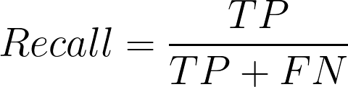
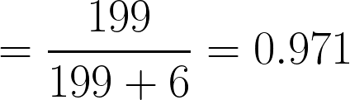
Confusion Matrix
Predicted Label
 | Ball | Dog | Toy
Ball | 205 | 10 | 1
Dog | 6 | 199 | 0
Toy | 9 | 17 | 223
Recall, True Positive Rate (TPR):
What proportion of actual positives was identified correctly?
Actual Label
=
+

Slide 4
Histogram (“dog” vs. “not dog”)
Actual negatives
Actual positives
True Negatives (TN)
True Positives (TP)
False Positives (FP)
Precision-Recall curve for “dog”
Number of times a particular result occurs
1.0
Precision
0.0
1.0
0.0
Recall
1.0
Threshold: 0.5
Confidence score
(for label “dog”): P_{dog}
False Negatives (FN)

Slide 5
Histogram (“dog” vs. “not dog”)
Actual negatives
Actual positives
True Negatives (TN)
True Positives (TP)
False Positives (FP)
Precision-Recall curve for “dog”
Number of times a particular result occurs
1.0
Precision
0.0
1.0
0.0
Recall
1.0
Threshold: 0.7
Confidence score
(for label “dog”): P_{dog}
False Negatives (FN)

Slide 6
Histogram (“dog” vs. “not dog”)
Actual negatives
Actual positives
True Negatives (TN)
True Positives (TP)
False Positives (FP)
Precision-Recall curve for “dog”
Number of times a particular result occurs
1.0
Precision
0.0
1.0
0.0
Recall
1.0
Threshold: 0.3
Confidence score
(for label “dog”): P_{dog}
False Negatives (FN)

Slide 7
Precision-Recall curve for “dog”
1.0
Precision
0.0
1.0
Recall

Slide 8
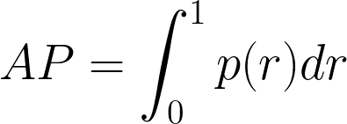
Average Precision (AP)
1.0
Precision
Area Under the Curve (AUC)
0.0
1.0
Recall

Slide 9
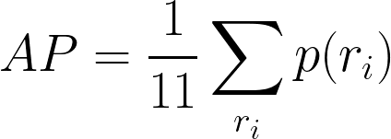
Average Precision (AP) approximation
1.0
PASCAL Visual Object Classes (VOC) Challenge (2009):
Precision
where r_{i} = [0.0, 0.1, 0.2, …, 1.0]
0.0
1.0
Recall

Slide 10
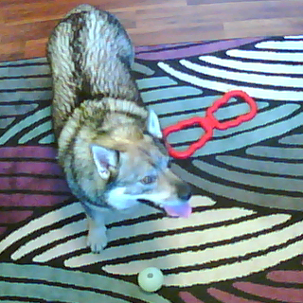
dog
dog
Object 1
Class: dog
Bounding box
(x₁, y₁)
(w₁, h₁)
Object 2
Class: toy
Bounding box
(x₂, y₂)
(w₂, h₂)
Object 3
Class: ball
Bounding box
(x₃, y₃)
(w₃, h₃)
toy
toy
ball

Slide 11

Intersection over Union (IoU)
Intersection: Area of overlap
Union: Area encompassed by both boxes
Ground-truth bounding box
Predicted bounding box
0.0 = complete miss
1.0 = perfect match
Object: IoU >= 0.5

Slide 12
With Th_{IoU} = 0.5:
dog
dog
IoU = 0.9
True Positive (TP)
Object 1
Class: dog
Bounding box
(x₁, y₁)
(w₁, h₁)
Object 2
Class: toy
Bounding box
(x₂, y₂)
(w₂, h₂)
Object 3
Class: ball
Bounding box
(x₃, y₃)
(w₃, h₃)
toy
toy
IoU = 0.2
False Positive (FP)
ball
False Negative (FN)

Slide 13
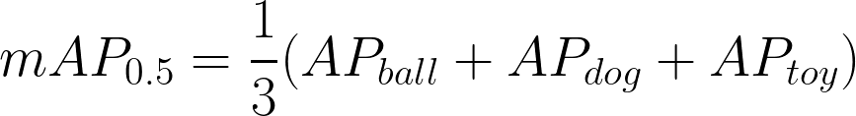
Precision-Recall curve (for IoU >= 0.5)
ball
1.0
dog
toy
mean Average Precision (mAP)
Precision
0.0
1.0
Recall

Slide 14
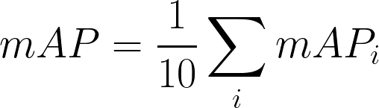
mAP (for several IoU thresholds)
Precision-Recall curves for “dog”
1.0
mean Average Precision (mAP)
Precision
Th_{IoU}=
0.5
COCO 2017 Challenge:
0.90
0.85
0.8
0.75
0.7
0.65
0.6
0.0
1.0
Recall
where i = [0.5, 0.55, 0.6, 0.65, 0.7, 0.75, 0.8, 0.85, 0.9, 0.95]

